Slide 1

Homing & Migration

Slide 2
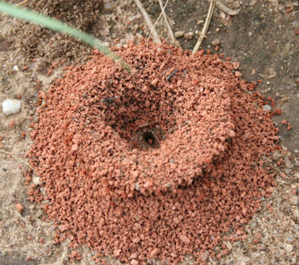
Homing
The ability of an animal to return to its home site (nest, burrow, lair, hive).
Animals need to leave to find food and mates but must be able to find it again
Home, sweet home

Slide 3
Migration
Regular, repeated movement in a certain direction by a whole population of animals
Usually :
  between feeding and breeding areas
  two way trip
  have regular timing
Often:
  long distance
  at a definite stage of the life cycle

Slide 4
Advantages
Favourable temperatures all year around
Constant food supply (no winter shortage)
Better chance for offspring to survive
Reduction of predation/parasitism
May lead to colonisation of new areas
May reduce intraspecific competition (e.g. if young in salt water and adults fresh)
Greater genetic mixing (if smaller groups join in breeding area)

Slide 5
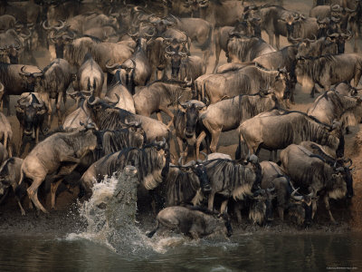
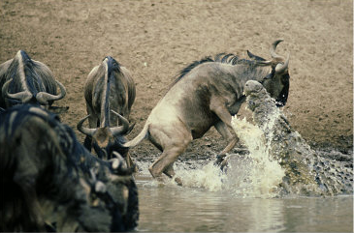
Disadvantages
Uses a huge amount of energy – could lead to exhaustion
Increased risk of getting lost or harmed
Predators may lie in wait

Slide 6
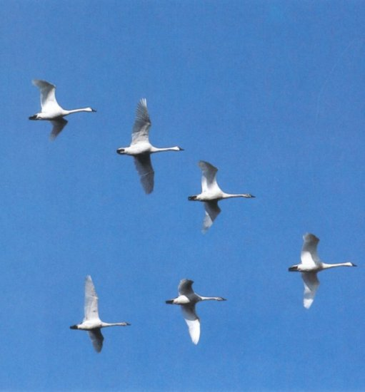
Examples
Many vertebrates
  Birds,
  Mammals
  Turtles
  Fish
Invertebrates
  Crustacea
  Insects
  Plankton

Slide 7
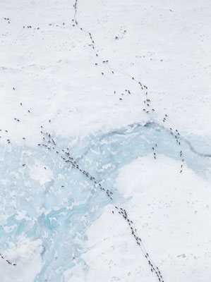
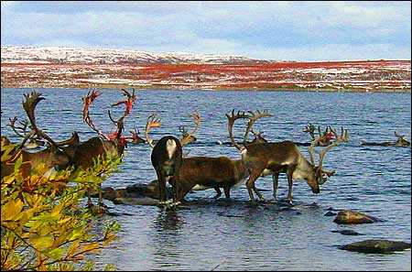
Caribou
Canada
Move South in winter
North in spring when calves are born

Slide 8
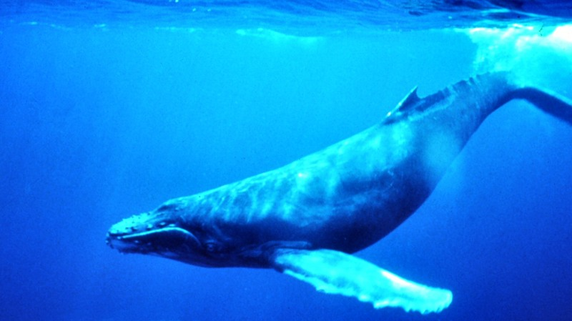
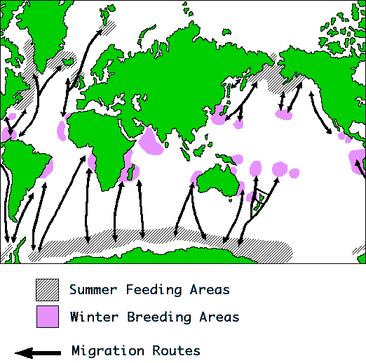
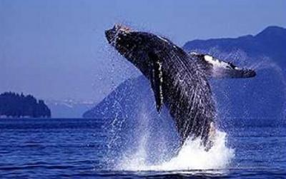
Humpback whales
Feed in polar seas in summer
Breed in tropics in winter

Slide 9
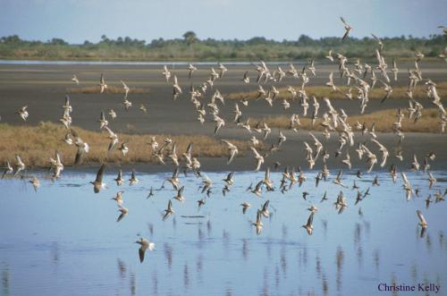
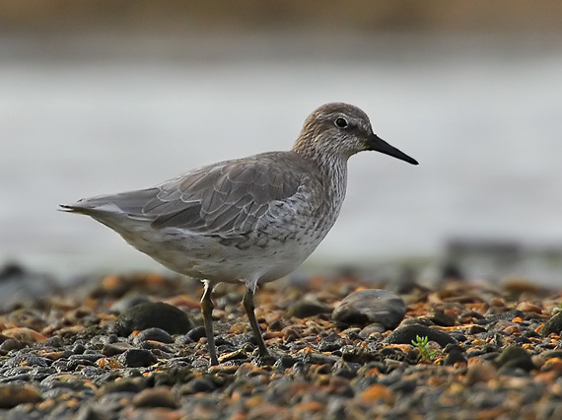
Knot
Breed in the arctic from Nth America to Siberia and migrate to N.Z. and Australia .
Found from Southland to Nth Auckland from Sept. to April.

Slide 10
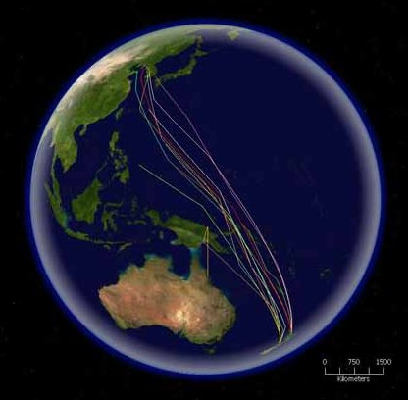
The bar-tailed Godwit
The Bar-tailed Godwit migrates in flocks to coastal East Asia, Alaska, Australia, Africa, northwestern Europe and New Zealand, where it is called Kūaka in Māori.

Slide 11
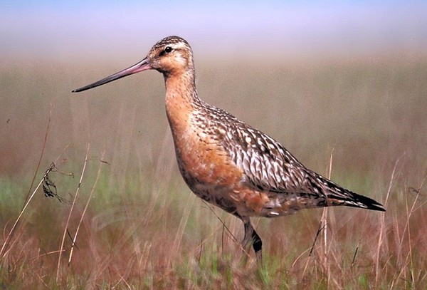
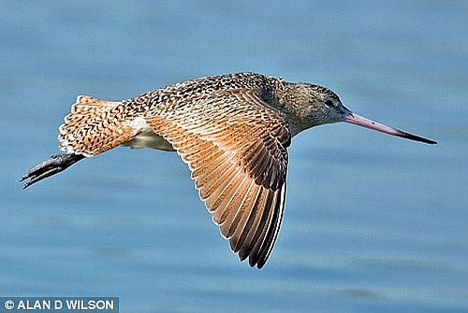
A female bar-tailed godwit, a wading bird called E7, has set a new record of having flown 6,230 miles for eight days across the Pacific Ocean to reach her winter home in New Zealand.

Slide 12
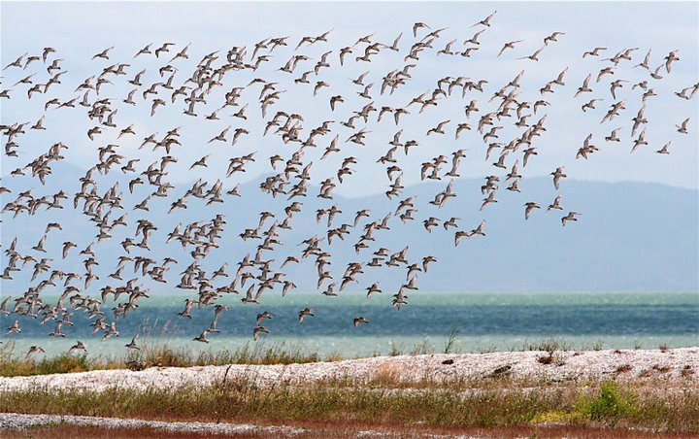
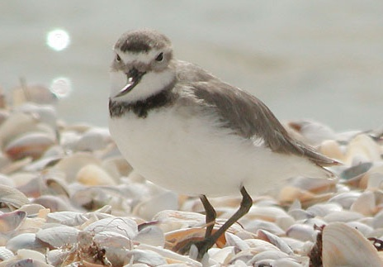
Wrybill
Breed on shingle banks of Sth. Island rivers in summer
Fly to northern North Island for winter.

Slide 13
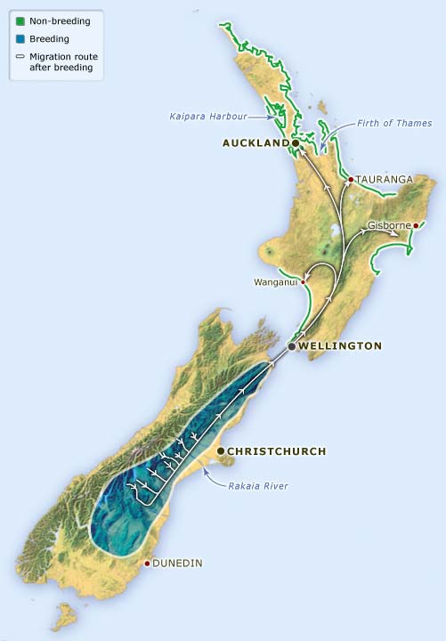
Wrybills migration routes

Slide 14
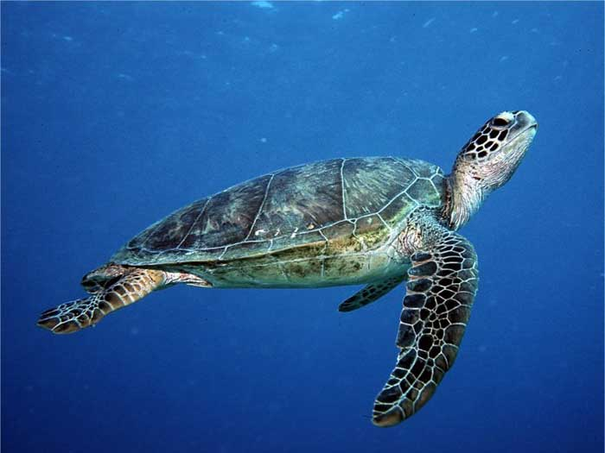
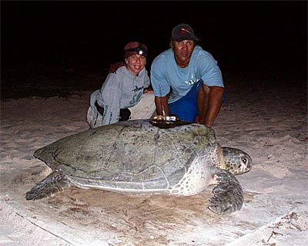
Green turtle
Found worldwide
Some migrate from feeding grounds off Brazil to mid Atlantic Ascension island to breed

Slide 15
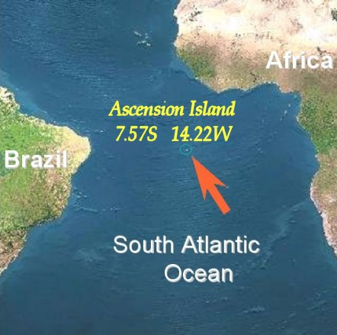
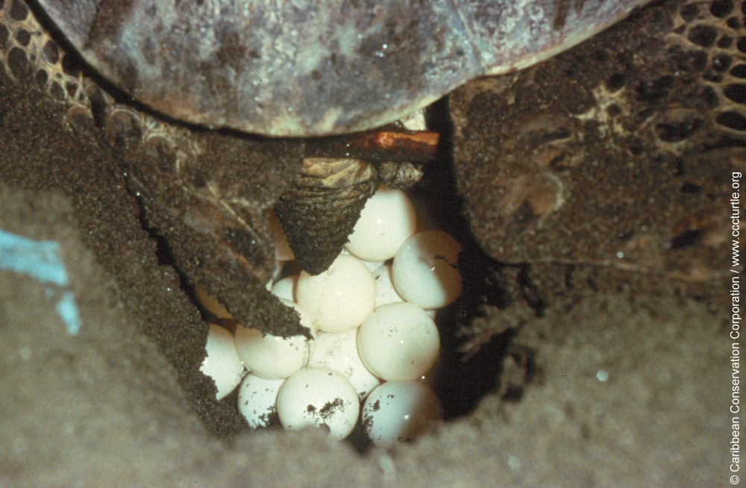
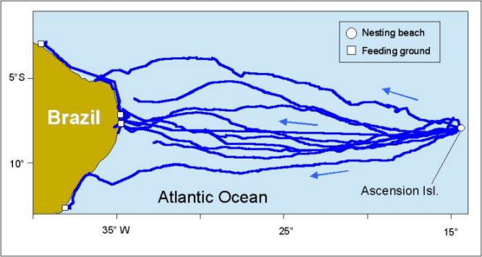
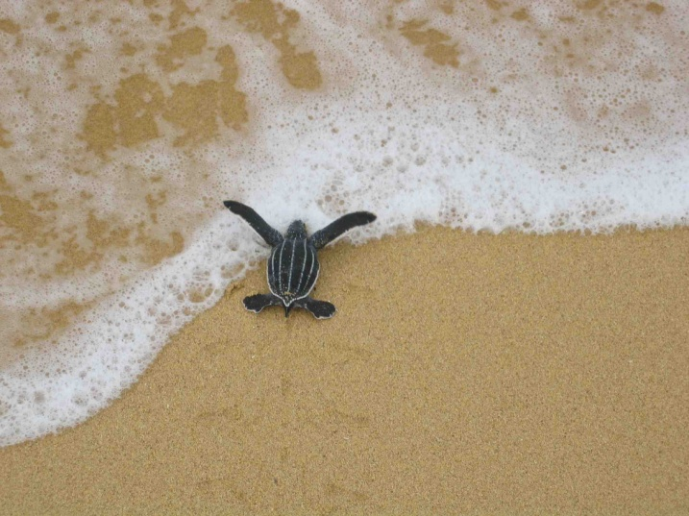

Slide 16
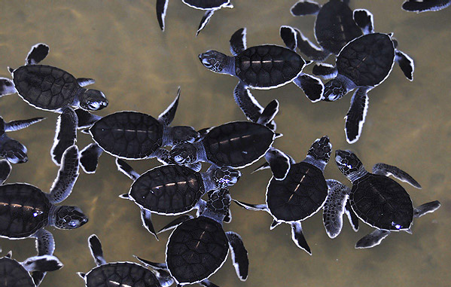

Slide 17
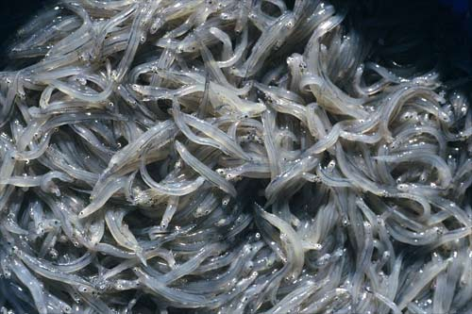
Whitebait
Swim up river in spring
Grow into adult inanga
When mature, swim down to estuaries
Spawn among plants on river bank during spring tide
Young hatch 2 weeks later, carried out to sea and spend about 2 years there before returning

Slide 18
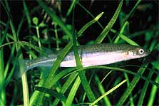
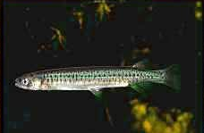
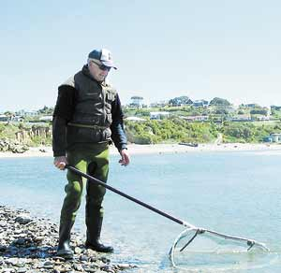
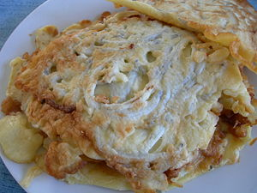
Random whitebait pics

Slide 19
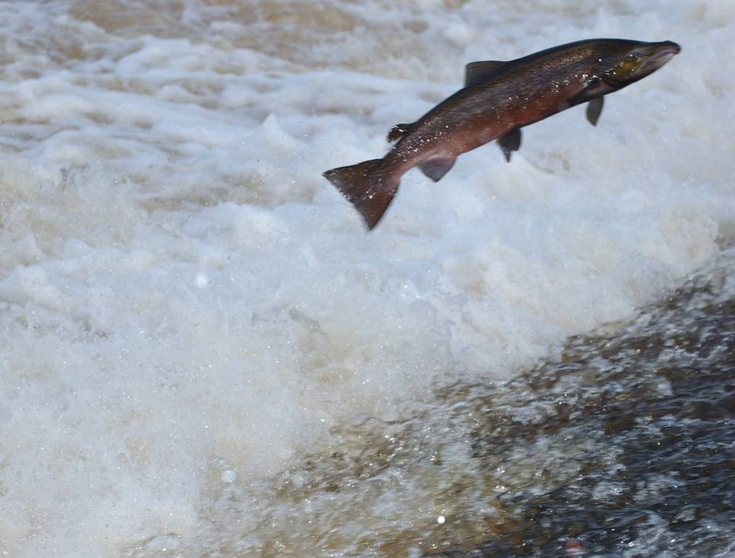
Salmon
Spend most of their adult life in the sea.
Migrate up rivers to spawn, returning to exactly where they were born using sense of smell
Return to sea as “fry”

Slide 20
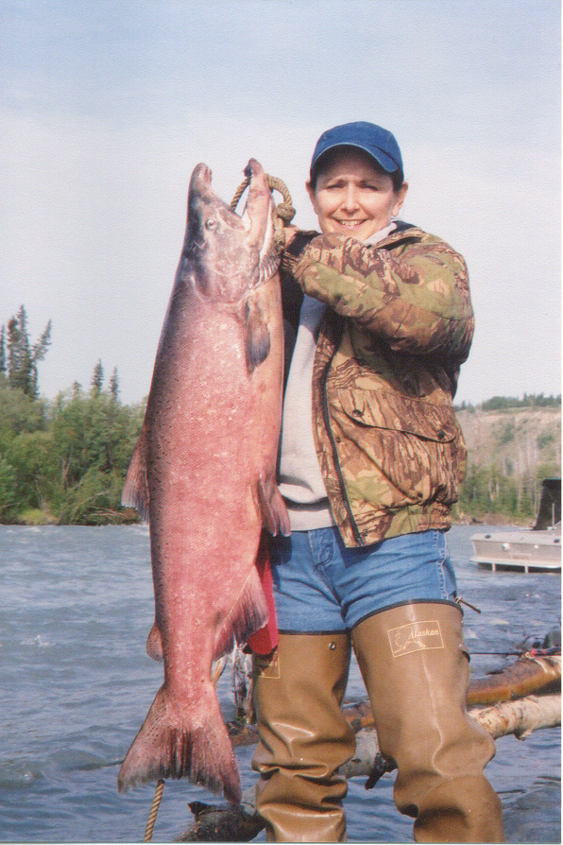
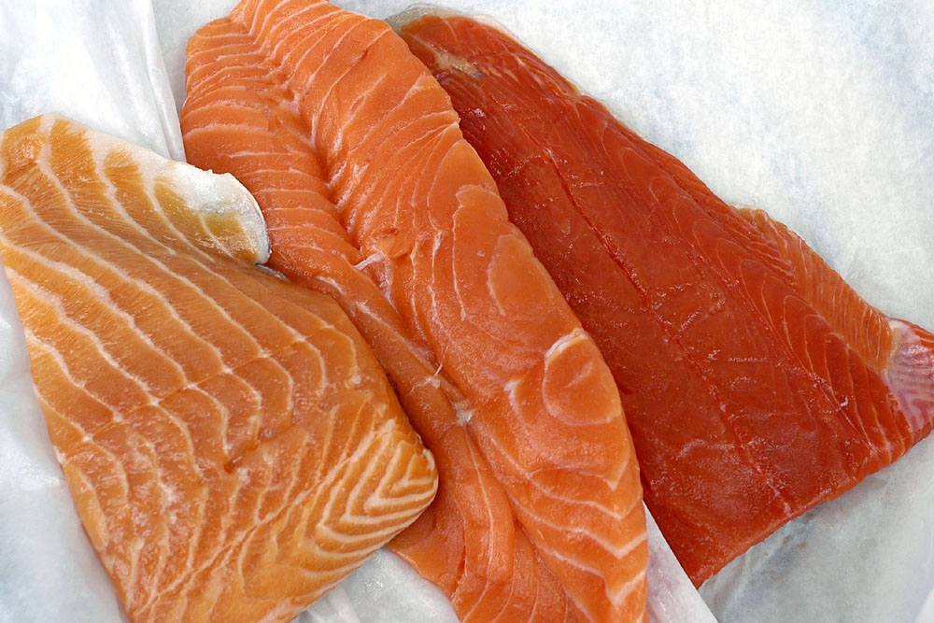

Unfortunately some salmon were harmed in order to bring you these pictures

Slide 21
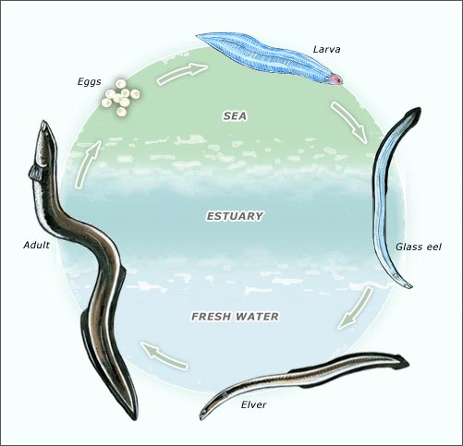
Eels
Eels hatch from eggs in the sea and migrate to land as glass eels (2 years)
Move up rivers as elvers
Grow to adults then migrate to sea 14-20 years later

Slide 22
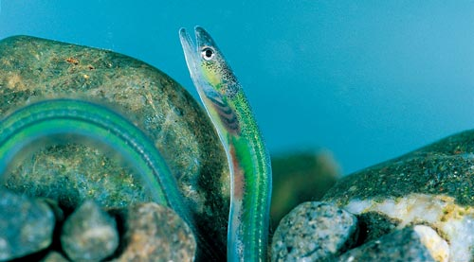
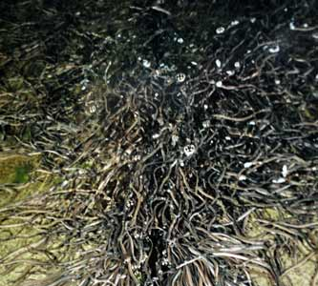
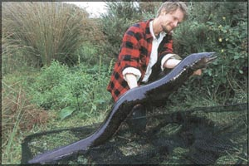
Elvers, Karapiro spillway
Glass eel
Adult eel

Slide 23
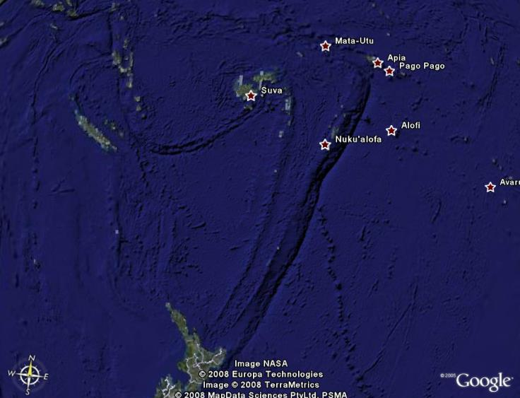
shortfin
longfin
The longfin eel is is thought to spawn east of Tonga.
The shortfin eel is thought to spawn northeast of Samoa.

Slide 24

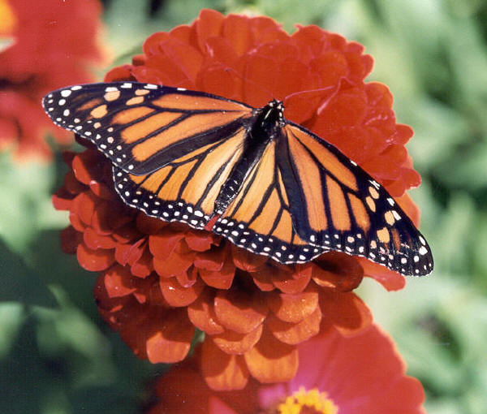
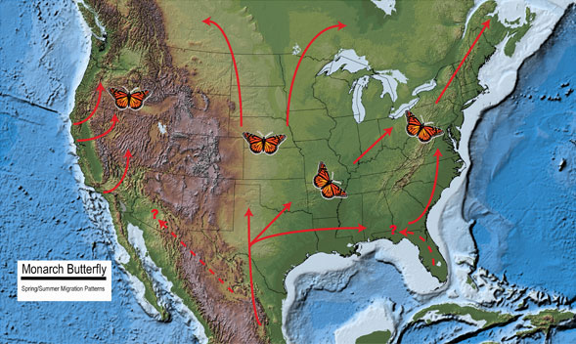
Monarch Butterflies
In America they migrate North in spring & summer, reproducing on the way. Their young continue the migration.

Slide 25
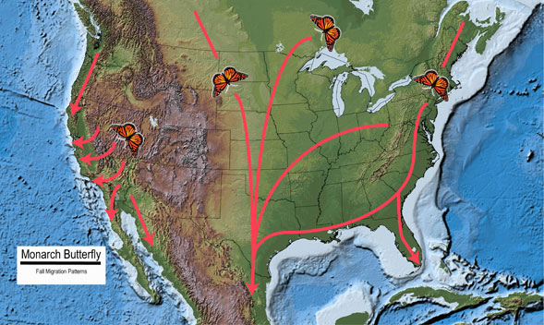
In autumn the surviving offspring migrate South to special over-wintering sites in California, Florida and Mexico

Slide 26
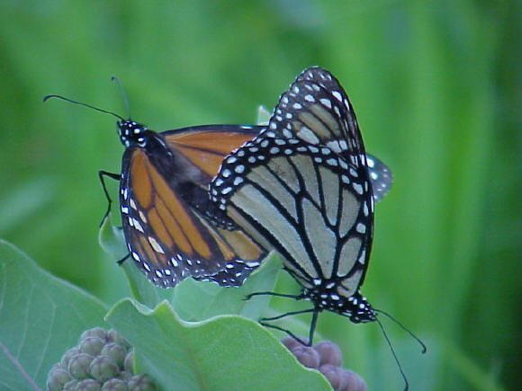
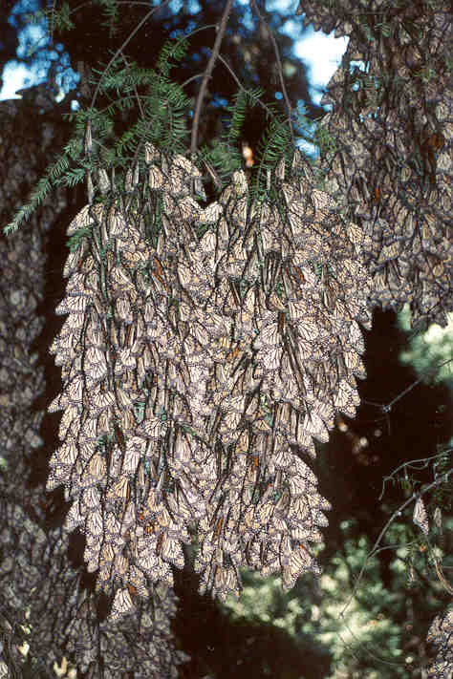
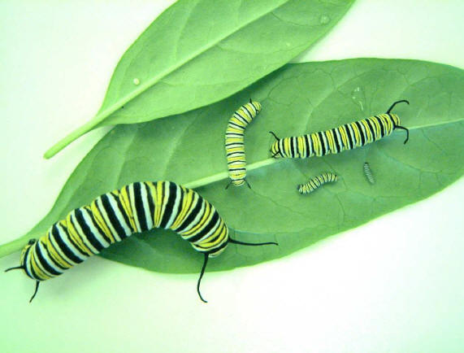

Slide 27

Triggers to Migration
Drop in temperature
Days become shorter. This triggers restlessness (zugunruhe)
Innate genetic drive
Reaching sexual maturity results in a desire to reproduce

